Slide 1
Digital Portfolio
STUDENT NAME: K. Kalaivanan
REGISTER NO AND NMID: asbru092422k2250
DEPARTMENT: B.Sc Computer Science
COLLEGE: COLLEGE/ UNIVERSITY Govt.Arts college
Bharathiyar University

Slide 2
PROJECT TITLE
Portfolio Website using HTML, CSS & JavaScript

Slide 3

AGENDA
Problem Statement
Project Overview
End Users
Tools and Technologies
Portfolio design and Layout
Features and Functionality
Results and Screenshots
Conclusion
Github Link
3/21/2024 Annual Review

Slide 4

PROBLEM STATEMENT
Many students have resumes, but they look static & plain.
Recruiters and faculty expect interactive, creative profiles.
I needed a modern portfolio to express my skills, hobbies, and ambitions.

Slide 5

PROJECT OVERVIEW
Designed and developed a web-based portfolio.
Highlights:
My personal details & profile picture
My skills & knowledge so far
My hobbies & passions
My future career goals
Responsive, interactive, and easy to use.

Slide 6

WHO ARE THE END USERS?
🎓 Students – Learn to build their own portfolios.
🏢 Recruiters – To evaluate skills beyond a resume.
👨‍🏫 Faculty/College – For academic project reviews.
🌍 Personal Use – Self-branding & online identity.

Slide 7
TOOLS AND TECHNIQUES
HTML5 → Structure of webpage
CSS3 → Layout, gradient background, animations
JavaScript → Dark/Light mode toggle, Back-to-Top button
Google Fonts (Poppins) → Modern typography
VS Code → Code editor

Slide 8
PORTFOLIO DESIGN AND LAYOUT
Navbar – Links to About, Skills, Projects, Goals, Contact
About Section – Profile + Hobbies
Skills Section – Current programming knowledge
Projects Section – Practice work (Portfolio site)
Future Goals Section – My career roadmap
Contact Section – Email & LinkedIn
Footer – Copyright
‹#›

Slide 9
FEATURES AND FUNCTIONALITY
🌙 Dark/Light Mode Toggle (with memory save)
⬆️ Back-to-Top Button for smooth navigation
✨ Hover animations & fade-in effects
📸 Stylish profile photo layout (rounded square)
🎨 Pleasant gradient background
📱 Responsive design for mobile & desktop

Slide 10
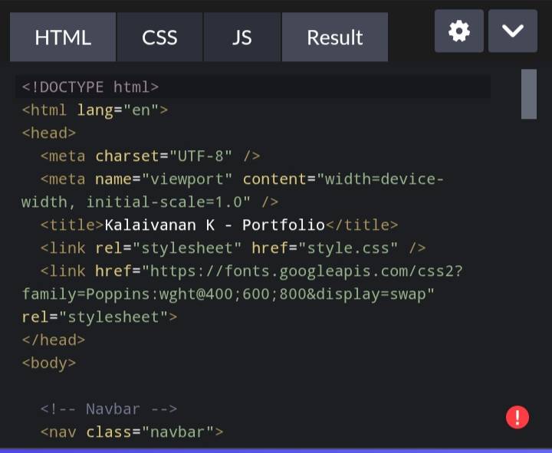
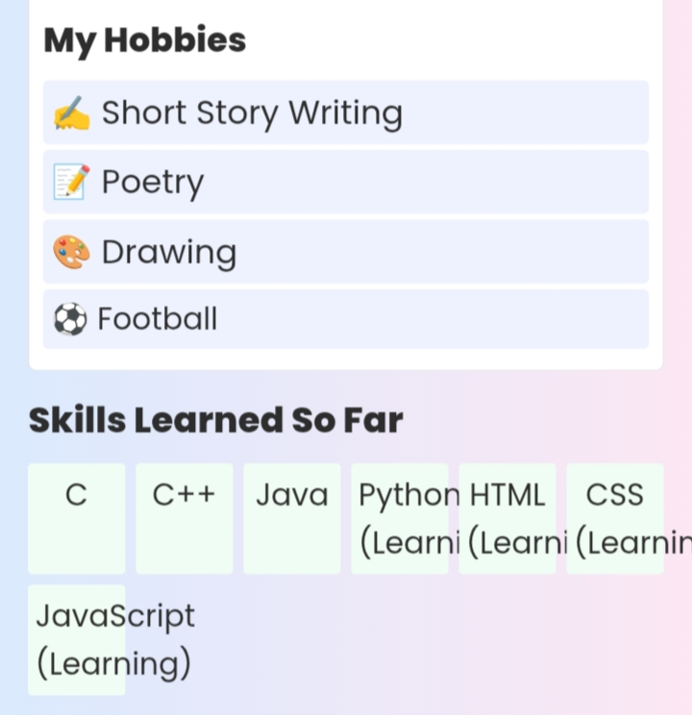
RESULTS AND SCREENSHOTS
3/21/2024 Annual Review
‹#›

Slide 11
CONCLUSION
✨ What I Learned:
Structuring pages with HTML
Designing with CSS (layouts, colors, animations)
Adding life with JavaScript (toggle, scroll)
✨ Thank you!
‹#›

